Slide 1

By: Fraida Levilev
SF_DAT_15

Slide 2
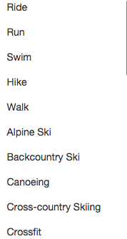
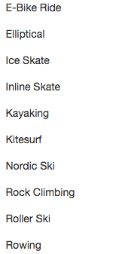
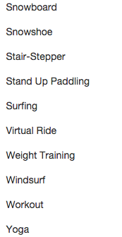
Strava Activities

Slide 3
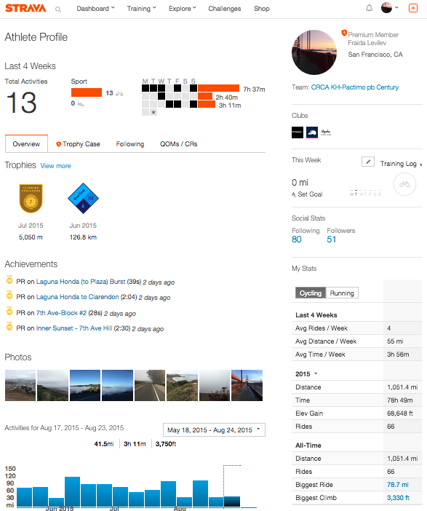

Slide 4
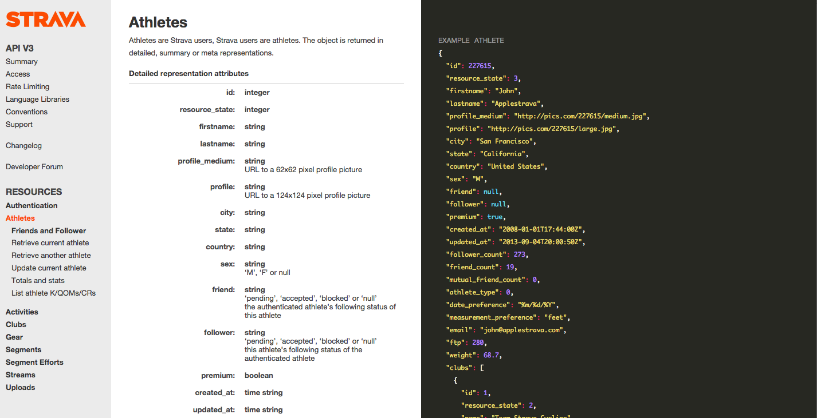

Slide 5
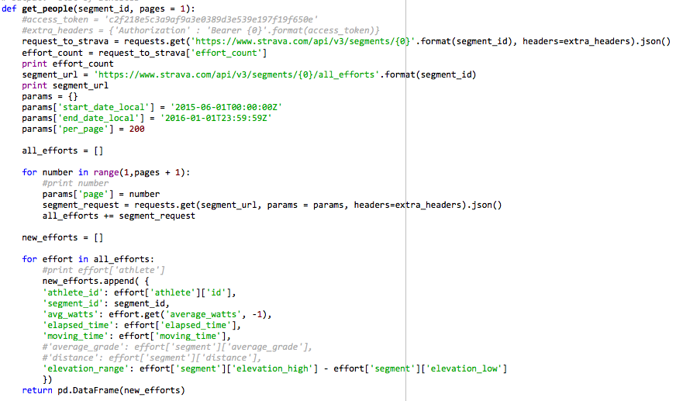
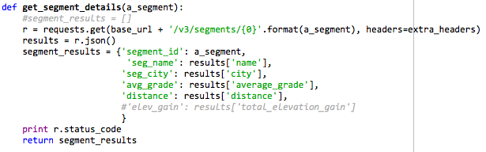
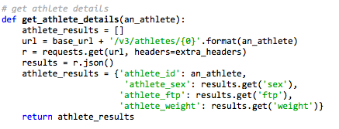
Functions
Efforts
Segments
Athletes

Slide 6
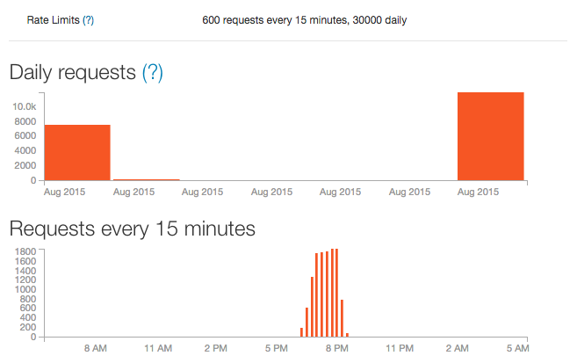

Slide 7
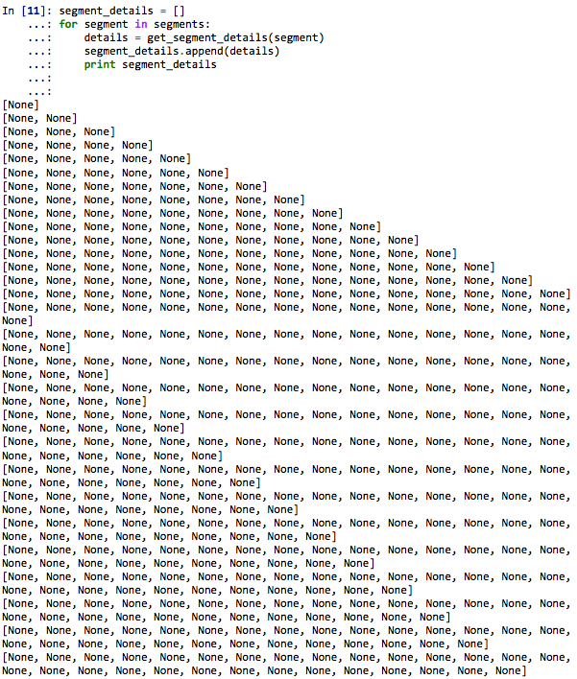
The “if Liam is wrong” function

Slide 8
Linear Regression
 | Features | MAE | MSE | RMSE | %
First | 4 | 136.841 | 56922.331 | 238.584 | 21.24%
Second | 11 | 99.476 | 34165.747 | 184.84 | 15.44%
Third | 43 | 84.065 | 30013.343 | 173.243 | 13.05%
Notes:
Coeff pretty much expected. HC added most time, descent cut most time.

Slide 9
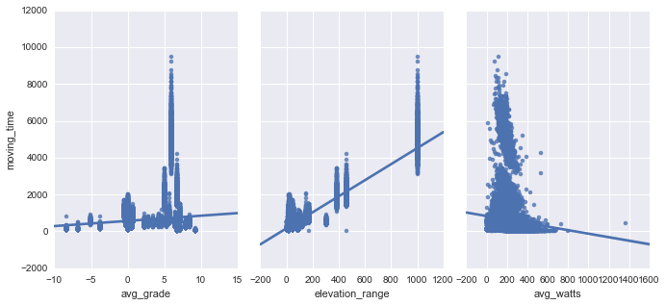
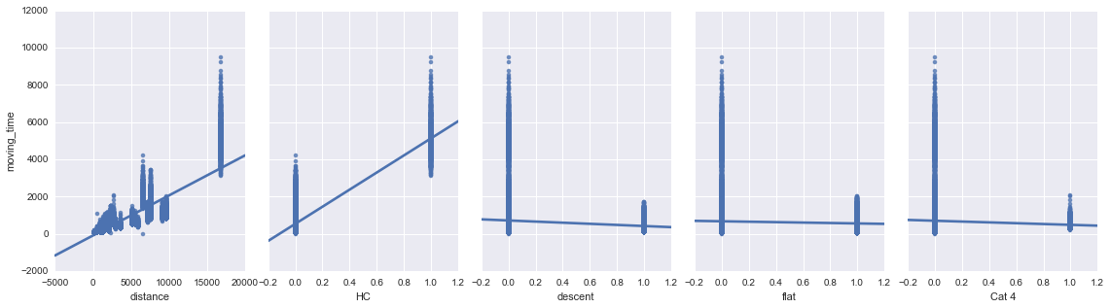

Slide 10
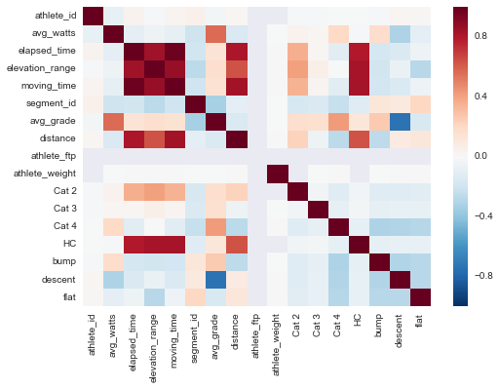

Slide 11
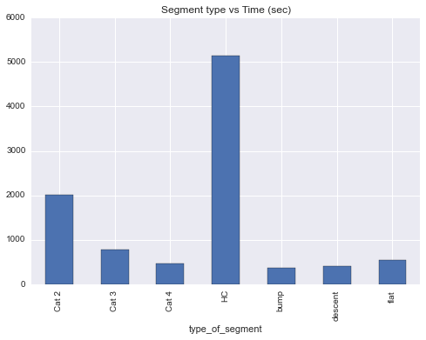

Slide 12
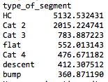
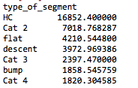
Average time vs Average distance

Slide 13
